Slide 1
Quick Sort
To sort a subarray A[p..r]
  Choose an element from the subarray as a pivot
Divide:
  Partition the array A[p..r] into two (possibly empty) subarrays A[p.. q-1] and A[q+1..r] such that each element of A[p..q-1] <= A[q] (pivot) and each element of A[q+1..r] >= A[q] (pivot)
Conquer
  Recursively sort the two subarrays A[p..q-1], A[q+1..r]
Combine: no work needs to be done.

Slide 2
The algorithm
quickSort(A, p, r)
{
if (p < r) {
q = partition(A, p, r);
quickSort(A, p, q-1);
quickSort(A, q+1, r);
}
}

Slide 3
Partition
int partition(A, p, r)
{
x = A[r]; // use A[r] as the pivot
i = p-1;
for (j=p; j<=r-1; j++) {
if (A[j] <= x) {
i++;
exchange(A[i], A[j]);
}
}
exchange(A[i+1], A[r]);
return i+1;
}

Slide 4
Example for Partition
i
j
2 | 8 | 7 | 1 | 3 | 5 | 6 | 4
i
j
2 | 8 | 7 | 1 | 3 | 5 | 6 | 4
i
j
2 | 8 | 7 | 1 | 3 | 5 | 6 | 4
i
j
2 | 8 | 7 | 1 | 3 | 5 | 6 | 4
i
j
2 | 1 | 7 | 8 | 3 | 5 | 6 | 4
Loop invariant: A[p..i] ≤ x < A[i+1..j-1]
at the beginning of iteration

Slide 5
Example for Partition
i
j
2 | 1 | 3 | 8 | 7 | 5 | 6 | 4
i
j
2 | 1 | 3 | 8 | 7 | 5 | 6 | 4
i
j
2 | 1 | 3 | 8 | 7 | 5 | 6 | 4
State when loop finishes
i
j
2 | 1 | 3 | 4 | 7 | 5 | 6 | 8
Final swap after loop

Slide 6
Analysis
Worst case: the array is sorted, Ω(n²)
Best case
  T(n) <= 2T(n/2) + Θ(n), T(n)  O(n log n)
Average case

Slide 7
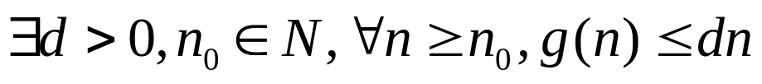
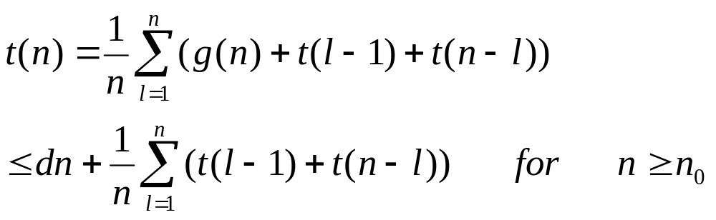
Average case
Assume the pivot chosen lies in any position with equal probability
Let t(m) be average time taken to sort m-elelemt array by quick sort.
The partition operation takes linear time g(n)  Θ(n). We know
We obtain the following recurrence

Slide 8
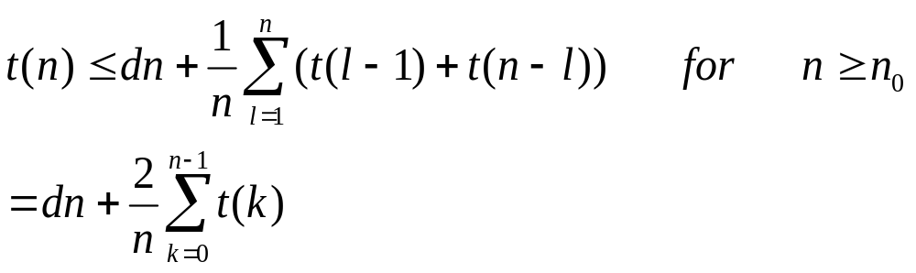
Constructive induction
We prove that t(n)  O(n log n)
  We need to show
  We choose n₁ = 2
  We have chosen n₀>=2 and d such that

Slide 9
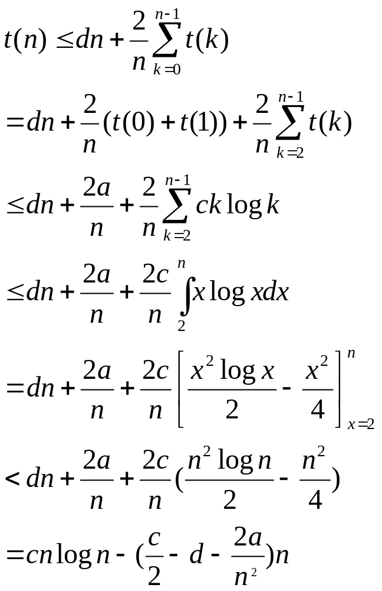
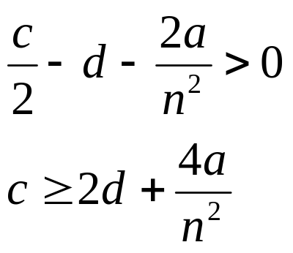
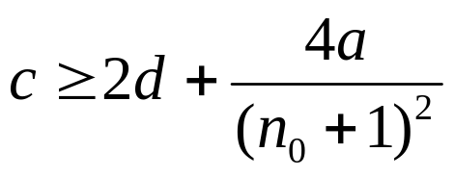
Induction step
We need
We know if n>n₀

Slide 10
Induction basis and Induction hypothesis
Basis: consider any integer n such that 2≤n≤n₀. We can choose c such that
  c >= t(n)/(nlog n) for all n such that 2≤n≤n₀
  Note that we can do this only because is n₀ fixed, i.e., it’s not a function of n
Hypothesis: Assume the induction hypothesis that t(k) <= c k log k for all k such that 2<=k<n.

